Slide 1

Algebra 1
Unit 14, Lesson H2 Interpreting Relative Frequency Tables and Segmented Bar Graphs Volume 2, pg. 331

Slide 2


Benchmarks
MA.912.DP.3.2
Given marginal and conditional relative frequencies, construct a two-way relative frequency table summarizing categorical bivariate data.
MA.912.DP.3.3
Given a two-way relative frequency table or segmented bar graph summarizing categorical bivariate data, interpret joint, marginal, and conditional relative frequencies in terms of a real-world context.
MA.912.DP.1.3
Explain the difference between correlation and causation in the contexts of both numerical and categorical data.
volume 2, pg. 331

Slide 3
Integrated Mathematical Thinking and Reasoning Standards
MA.K12.MTR.1.1 Actively participate in effortful learning both individually and collectively.
MA.K12.MTR.2.1 Demonstrate understanding by representing problems in multiple ways.
MA.K12.MTR.3.1 Complete tasks with mathematical fluency.
MA.K12.MTR.4.1 Engage in discussions that reflect on the mathematical thinking of self and others.
MA.K12.MTR.5.1 Use patterns and structure to help understand and connect mathematical concepts.
MA.K12.MTR.6.1 Assess the reasonableness of solutions.
MA.K12.MTR.7.1 Apply mathematics to real-world contexts.
volume 2, pg. 331

Slide 4

Learning Targets
I can construct a two-way relative frequency table.
I can interpret joint, marginal, and conditional relative frequencies in a real-world context.
volume 2, pg. 331

Slide 5

Warm-Up
volume 2, pg. 331

Slide 6
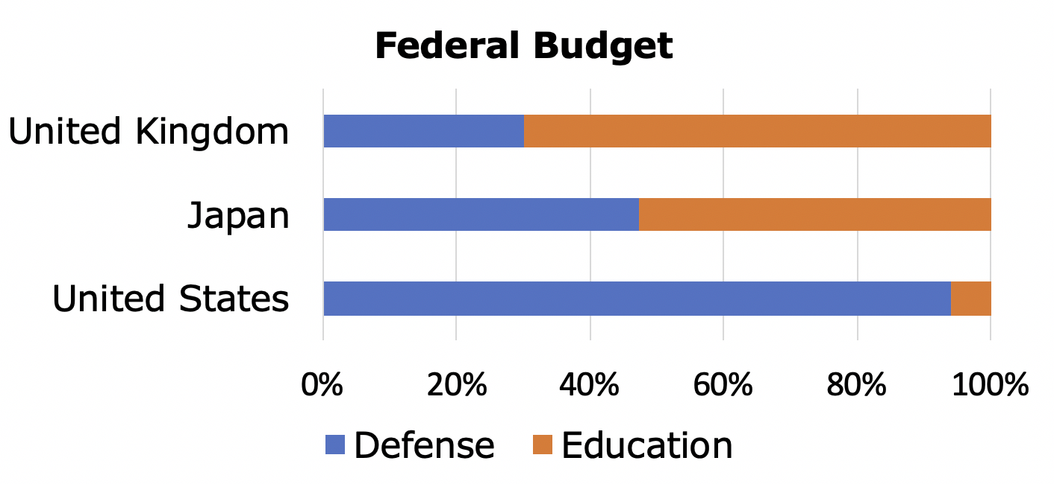
14.H2.1 Warm-Up: Notice and Wonder
The segmented bar graph represents the distribution of where some of the 2009 federal budgets were expected to go.
volume 2, pg. 331

Slide 7
What do you notice?
What do you wonder?
volume 2, pg. 331

Slide 8

Collaboration
volume 2, pg. 332

Slide 9

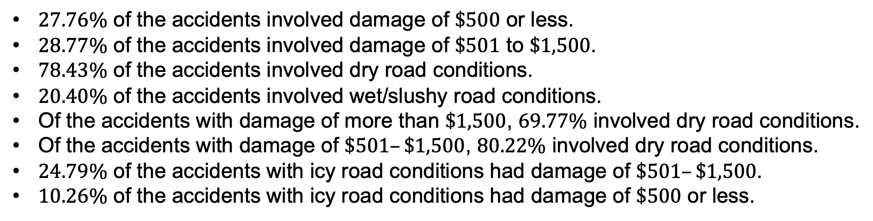
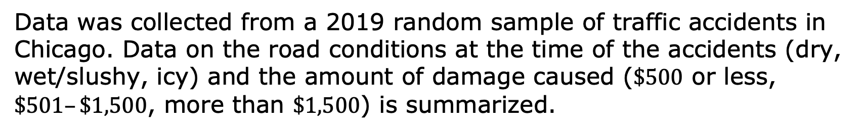
14.H2.2 Collaboration: Two-Way Relative Frequency Tables
Data was collected from a 2019 random sample of traffic accidents in Chicago. Data on the road conditions at the time of the accidents (dry, wet/slushy, icy) and the amount of damage caused ($\$500$ or less, $\$501–\$1,500$, more than $\$1,500$) is summarized.
$27.76\%$ of the accidents involved damage of $\$500$ or less.
$28.77\%$ of the accidents involved damage of $\$501$ to $\$1,500$.
$78.43\%$ of the accidents involved dry road conditions.
$20.40\%$ of the accidents involved wet/slushy road conditions.
Of the accidents with damage of more than $\$1,500$, $69.77\%$ involved dry road conditions.
Of the accidents with damage of $\$501–\$1,500$, $80.22\%$ involved dry road conditions.
$24.79\%$ of the accidents with icy road conditions had damage of $\$501–\$1,500$.
$10.26\%$ of the accidents with icy road conditions had damage of $\$500$ or less.
volume 2, pg. 332

Slide 10
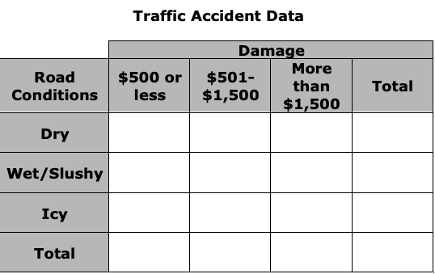
Use the data provided to construct a two-way relative frequency table. Round values to the nearest hundredth.
volume 2, pg. 332

Slide 11
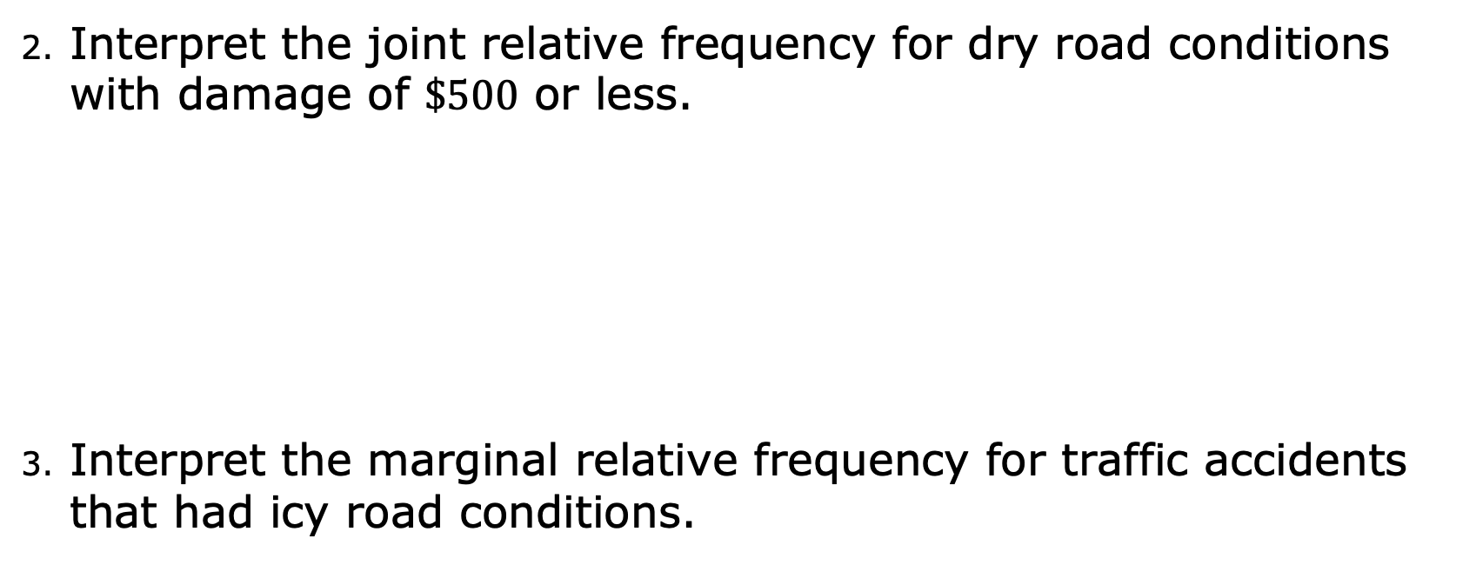
Interpret the joint relative frequency for dry road conditions with damage of $\$500$ or less.
Interpret the marginal relative frequency for traffic accidents that had icy road conditions.
volume 2, pg. 332

Slide 12


When the road conditions are icy, is the likelihood of the different amounts of damage the same? Explain your reasoning using conditional relative frequencies.
Does there appear to be an association between road conditions and the amount of damage caused?
Does this mean that more hazardous road conditions cause more damage in traffic accidents?
Association does not imply causation!
If there is an association between two variables, it does not mean that one causes the other.
Two variables can be associated without having a causal relationship.
volume 2, pg. 333

Slide 13
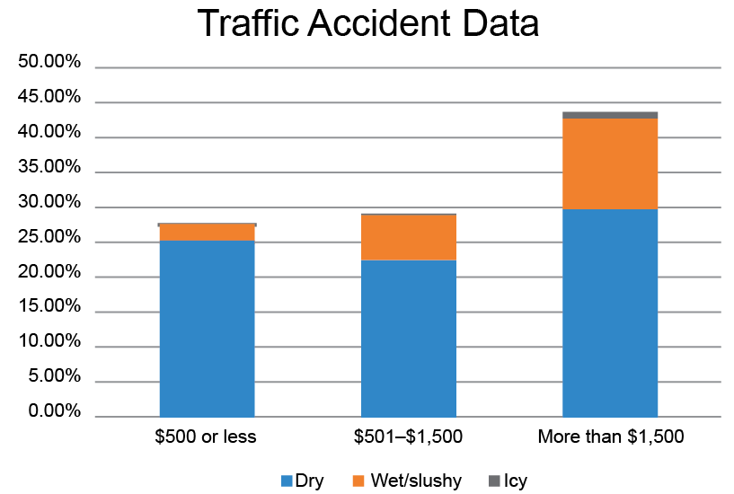
Another way to represent bivariate categorical data from a two-way relative frequency table is with a segmented bar graph. These graphs are helpful in visualizing comparisons between different variables by identifying how much larger or smaller different parts of each bar are compared to other bars.
The data from the two-way frequency table can be displayed in a segmented bar graph as shown.
With your partner, discuss the similarities and differences between the two-way relative frequency table and the segmented bar graph. Summarize your discussion.
volume 2, pg. 333

Slide 14

Try It
volume 2, pg. 334

Slide 15

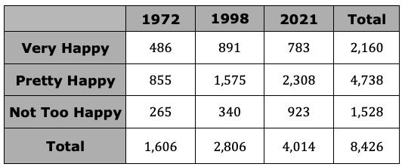
14.H2.3 Try It: Interpreting Relative Frequencies
The General Social Survey (GSS) interviews a random sample of Americans every two years. In one question, respondents are asked to rate their general happiness level. Sample results for 1972, 1998, and 2021 are summarized in the table.
volume 2, pg. 334

Slide 16
After reviewing the two-way frequency table, Diana said, “It seems like people in 2021 were a lot happier than in 1972.”
Why do you think Diana said this?
Explain why this may not be an accurate conclusion to draw from the data.
volume 2, pg. 334

Slide 17

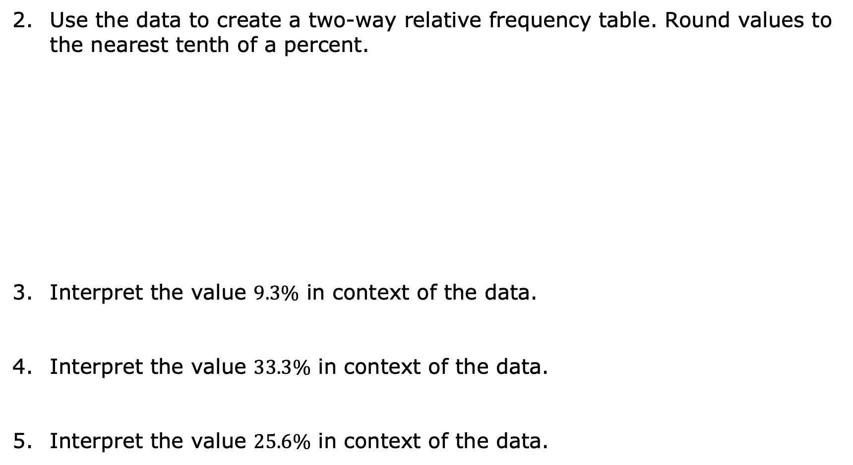
Use the data to create a two-way relative frequency table. Round values to the nearest tenth of a percent.
Interpret the value $9.3\%$ in context of the data.
Interpret the value $33.3\%$ in context of the data.
Interpret the value $25.6\%$ in context of the data.
volume 2, pg. 334

Slide 18
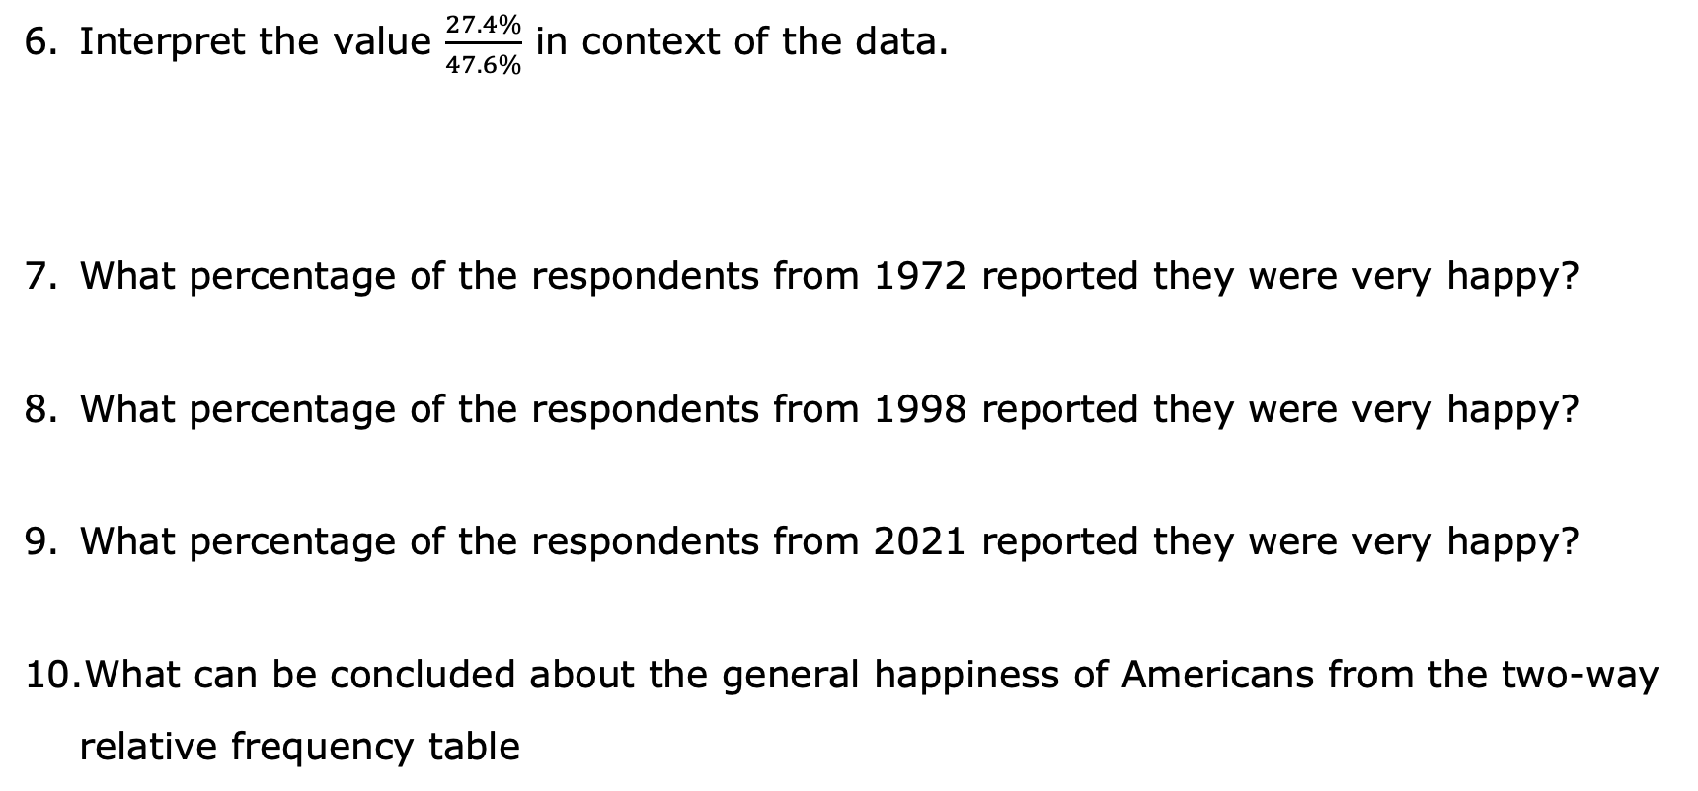
Interpret the value $\frac{27.4\%}{47.6\%}$ in context of the data.
What percentage of the respondents from 1972 reported they were very happy?
What percentage of the respondents from 1998 reported they were very happy?
What percentage of the respondents from 2021 reported they were very happy?
What can be concluded about the general happiness of Americans from the two-way relative frequency table
volume 2, pg. 335

Slide 19

Wrap-Up
volume 2, pg. 335

Slide 20
14.H2.4 Wrap-Up: Ticket Out the Door
The RMS Titanic was a British passenger liner operated by the White Star Line that sank in the North Atlantic Ocean on April 15, 1912, after striking an iceberg during her maiden voyage from Southampton to New York City.
The two-way relative frequency table classifies the passengers as whether the person survived (Yes or No) and the class of the ticket they had (1st, 2nd, 3rd, or Crew).
volume 2, pg. 335

Slide 21
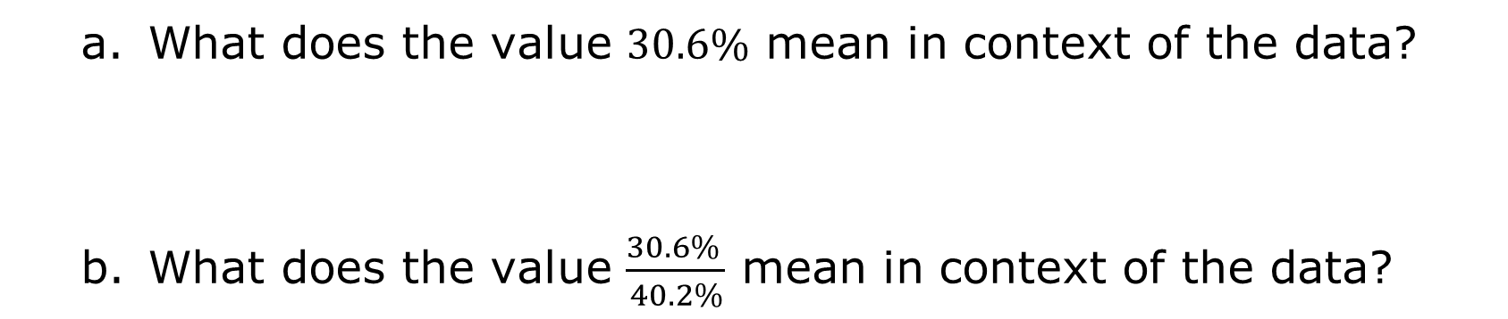
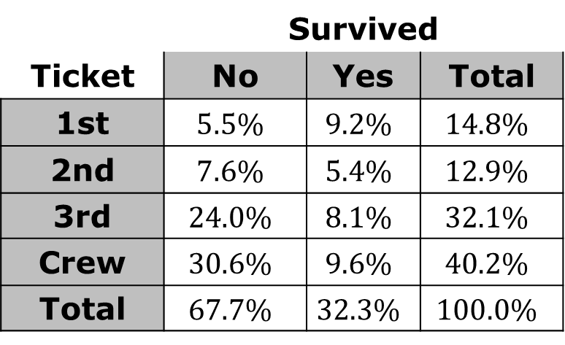
 | Survived
Ticket | No | Yes | Total
1st | $$5.5\%$$ | $$9.2\%$$ | $$14.8\%$$
2nd | $$7.6\%$$ | $$5.4\%$$ | $$12.9\%$$
3rd | $$24.0\%$$ | $$8.1\%$$ | $$32.1\%$$
Crew | $$30.6\%$$ | $$9.6\%$$ | $$40.2\%$$
Total | $$67.7\%$$ | $$32.3\%$$ | $$100.0\%$$
What does the value $30.6\%$ mean in context of the data?
What does the value $\frac{30.6\% }{40.2\%}$ mean in context of the data?
volume 2, pg. 335

